Slide 1

Transaction Management Part 2

Slide 2
Serializability
In a database system, we can have number of transaction processing. Related transactions will be processed one after another. There are some transactions processes in parallel. Some of the transactions can be grouped together.
A schedule is a process of grouping the transactions into one and executing them in a predefined order. A schedule is required in a database because when some transactions execute in parallel, they may affect the result of the transaction - means if one transaction is updating the values which the other transaction is accessing, then the order of these two transactions will change the result of second transaction. Hence a schedule is created to execute the transactions.
A schedule is called serial schedule, if the transactions in the schedule are defined to execute one after the other.

Slide 3
Even when we are scheduling the transactions, we can have two transactions in parallel, if they are independent. But if they are dependent, then the results will change.
For example, say one transaction is updating the marks of a student in one subject; meanwhile another transaction is calculating the total marks of a same student.
If the second transaction is executed after first transaction is complete, then both the transaction will be correct.
But what if second transaction runs first? It will have wrong total mark.

Slide 4
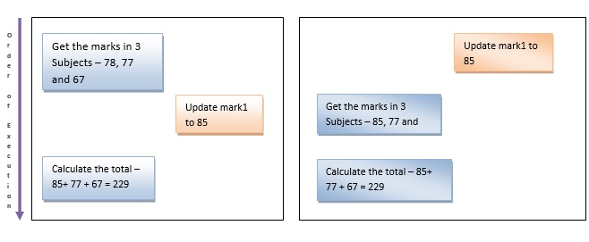

This type of incorrect processing of transaction needs to be handled in the system. Parallel execution of transaction is allowed in the database only if there is any equivalence relation among the transactions.
78
222

Slide 5
There are three types of equivalence relation among the transactions – Result, View and Conflict Equivalence.
Result Equivalence: - If the two transactions generate same result after their execution then it is called as result equivalence.
For example, one transaction is updating the marks of Student X and the other transaction is to insert a new student. Here both the transactions are totally independent and their order of execution does not matter. Whichever order they are executed; the result is the same. Hence it is called result equivalence transactions.

Slide 6
View Equivalence: -Two schedules are said to be view equivalence, if the transaction in one schedule is same as the one in other. That means, both the transactions in two schedules perform same tasks.
For example, say schedule1 has transaction to insert new students into STUDENT table and second schedule has the transaction to maintain the old student records in a new table called OLD_STUDENT. In both the schedules student details are inserted, but different tables (it does not matter if it is same table). Such schedules are called as view equivalence schedule.

Slide 7
Conflict Equivalence: - In this case both schedules will have different set of transactions, but they would be accessing same data and one of the schedules will be inserting/updating the records. In this equivalence, both the schedules will have conflicting set of transactions. In example of updating the marks of one student by one transaction and calculating the total marks at the same time is a conflicting equivalence.
In all these cases if the transaction is serialized, then the issues can be resolved.

Slide 8
Concurrency Control
When there are multiple transactions executing at the same time on same data, it may affect the result of the transaction. Hence it is necessary to maintain the order of execution of those transactions.
In addition, it should not alter the ACID property of a transaction.
In order to maintain the concurrent access of transactions, some protocols are introduced.

Slide 9
Concurrency Control
Lock Based Protocol: - A lock is a mechanism to control concurrent access to a data item. Lock is in other words called as access.
A locking protocol is a set of rules followed by all transactions while requesting and releasing locks.
In this type of protocol any transaction will not be processed until the transaction gets the lock on the record.
That means any transaction will not retrieve or insert or update or delete the data unless it gets the access to that particular data.

Slide 10
These locks are broadly classified as Binary locks and shared / exclusive locks.
In binary lock data can either be locked or unlocked. It will have only these two states. It can be locked for retrieve or insert or update or delete the data or unlocked for not using the data.
Exclusive lock (X) mode. Data item can be both read as well as written. X-lock is requested using lock-X instruction. In this technique the data is said to be exclusively locked for insert / update /delete. When it is exclusively locked no other transaction can read or write the data.
Shared (S) mode. Data item can only be read. S-lock is requested using lock-S instruction. When a data is read from the database, then its lock is shared i.e.; the data can be read by other transaction too but it cannot be changed while retrieving the data.

Slide 11
Simplistic Lock Protocol: -As the name suggests it is the simplest way of locking the data during the transaction. This protocol allows all the transaction to get the lock on the data before insert / update /delete on it. After completing the transaction, it will unlock the data.
Pre-claiming Protocol: - In this protocol, it evaluates the transaction to list all the data items on which transaction needs lock. It then requests DBMS for the lock on all those data items before the transaction begins. If DBMS gives the lock on all this data, then this protocol allows the transaction to begin. Once the transaction is complete, it releases all the locks.

Slide 12
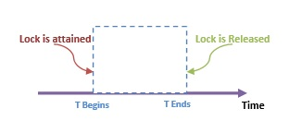
For example, if we have to calculate total marks of 3 subjects, then this protocol will evaluate the transaction and list the locks on subject1 marks, subject2 marks and then subject3 marks. Once it gets all the locks, it will start the transaction.

Slide 13
Lock-Based Protocols (Cont.)
Example of a transaction performing locking:
T₂: lock-S(A);
read (A);
unlock(A);
lock-S(B);
read (B);
unlock(B);
display(A+B)

Slide 14
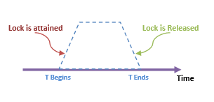
Two Phase Locking Protocol (2PL): - In this type of protocol, as the transaction begins to execute, it starts requesting for the locks that it needs. It goes on requesting for the locks as and when it is needed. Hence it has a growing phase of locks. At one stage it will have all the locks. Once the transaction is complete it goes on releasing the locks. Hence it will have descending phase of locks. Thus this protocol has two phases:
Phase1: Growing phase of locks,
Phase 2: Shrinking phase of locks.

Slide 15
For example, if we have to calculate total marks of 3 subjects, then this protocol will go on asking for the locks on subject1 marks, subject2 marks and then subject3 marks.
As and when it gets the locks on the subject marks it reads the marks. It does not wait till all the locks are received. Then it will have total calculation.
Once it is complete it release the lock on subject3 marks, subject2 marks and subject1 marks.

Slide 16
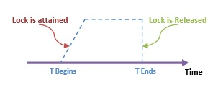
Strict Two Phase Locking (Strict 2PL): - This protocol is similar to 2PL in the first phase. Once it receives the lock on the data, it completes the transaction. Here it does not release the locks as it is used and no more required. It waits till whole transaction to complete and commit, then it releases all the locks at a time. This protocol hence does not have shrinking phase of lock release.
In the example of calculating total marks of 3 subjects, locks are achieved at growing phase of the transaction and once it receives all the locks, it executes the transaction. Once the transaction is fully complete, it releases all the locks together.

Slide 17
Time Stamp Based Protocol: - In this method, as soon as a transaction is created it assigns the order of the transaction. The order of the transaction is nothing but the ascending order of the transaction creation.
The priority for older transaction is given to execute first. This protocol uses system time or logical counter to determine the time stamp of the transaction.
Suppose there are two transactions T1 and T2. Suppose T1 has entered the system at time 0005 and T2 has entered the system at 0008 clock time. Priority will be given to T1 to execute first as it is entered the system first.
In addition to the timestamp of a transaction, this protocol also maintains the timestamp of last ‘read’ and ‘write’ operation on a data. Based on the timestamp of transaction and the data which it is accessing a timestamp ordering protocol is defined.

Slide 18
END

